Slide 1
Into the Tidyverse Session 5a
Course written by Tim Hardgreeves

Slide 2
Filling in the missing pieces
In particular we will have a look at writing R scripts, saving dataframes, and outputting plots

Slide 3
R Scripts

Slide 4
Creating R scripts
So far, most of us have been writing R code directly into the RStudio console
This works fine for experimental work but can get frustrating if our analyses are long and complex
It also makes it very difficult to share code with anybody else
An alternative to this is using R scripts
We create an R script navigating to File > New File > R Script or using Ctrl-Shift-N

Slide 5
Saving Dataframes

Slide 6
Saving a dataframe
If you are working with large datasets or complex pipelines you often won't want to re-run your code
This can be avoided by saving a copy of a dataframe as a CSV file to be read in again when needed
We can do this using the write_csv() function from readr
This takes two main arguments.
The first is the dataframe you wish to save
second is a path for where to save the file (e.g. 'data/my_data.csv’ )
~By default, this will overwrite any existing file though you can specify append = TRUE to instead append the contents~

Slide 7
Saving a figure
Similarly, we can save plots using a ggplot2 function called ggsave:
The plot we want to save otherwise it defaults to your last plot
specify a file name as the first argument which will be combined with an optional path argument
For example, a file name of 'my_plot.png' and a path of 'output' will create a plot in 'output/my_plot.png’
There are additional parameters that you may want to specify:
The most important parameters are device, scale, width, height, and dpi

Slide 8
Exercises to try
Write the head of the iris dataset to a CSV file called ‘iris.csv’
Now, append the tail of the same dataset to the same CSV file

Slide 9
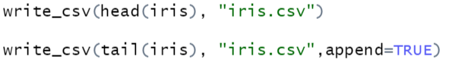
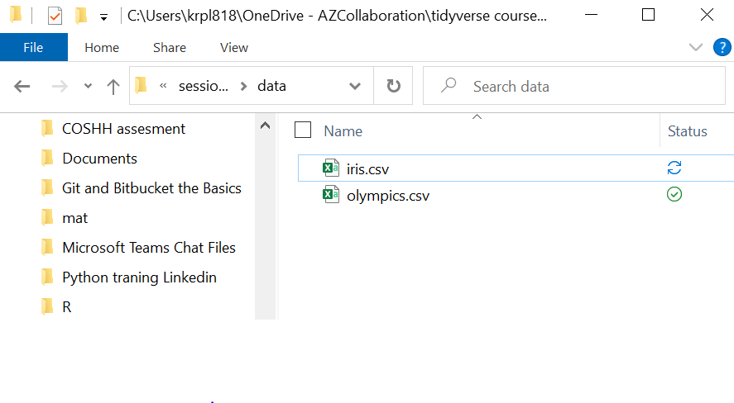
Answers
1)
2)

Slide 10
Advanced Data Visualisation

Slide 11
What is ‘Advanced’?
This session will still only scratch the surface of ggplot2's potential
We will however cover quite a few important areas for making exciting and good-looking graphics:
Statistical Transformations
Positional Adjustments
Coordinate Systems
Themes

Slide 12
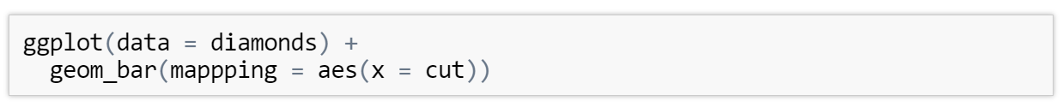
Bar charts
We can also use ggplot to create bar charts using the geom_bar() geometry
Here we create a bar chart of the cuts in the diamonds dataframe

Slide 13
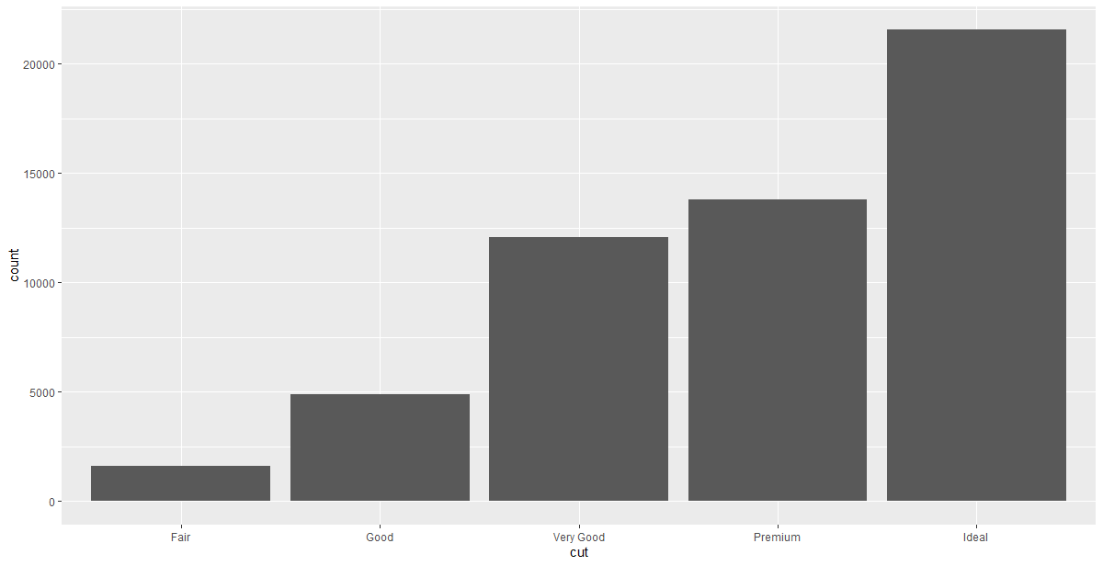
Bar chart
On the x-axis we have a variable we recognise, cut, but on the y-axis we have a variable, count, that didn't appear anywhere in the original dataset

Slide 14
Uses of different graph types
Simple graphs, like scatter plots and line plots, plot the raw values of the dataset directly
More complex graphs, such as the bar chart, actually calculate new variables to be plotted
Bar charts, histograms, and frequency polygons bin your data and then plot the bin counts
Smoothers (geom_smooth()) fit a model to your data and then plot the model predictions
Boxplots compute a robust summary of the distribution of your data and then plot this in a specially formatted way

Slide 15
Exercise to try
Create a bar chart using the manufacturer column of the mpg dataset. Save this as an .png file
For this you need to use ggsave( <file_name_and_extension> , plot_name)

Slide 16
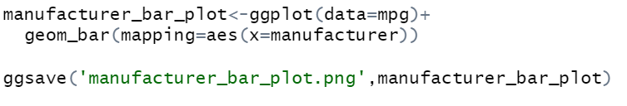
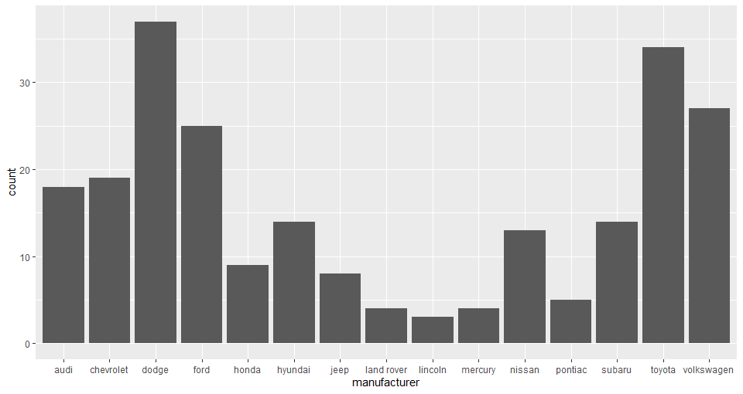
Answer

Slide 17
Stats

Slide 18
Stats
The algorithm used to calculate new values for a graph is called a stat (short for statistical transformation)
We can find out which stat a particular geom uses by looking at the corresponding help page
For example the help page for geom_bar() states that the default value for the stat parameter is “count”
stat_count() is documented on the same page as geom_bar()
If you scroll down and look the section titled 'Computed Variables', we can see that it computes two new variables, count and prop
Every geom has a default stat so we rarely need to worry about about the underlying statistical transformation

Slide 19
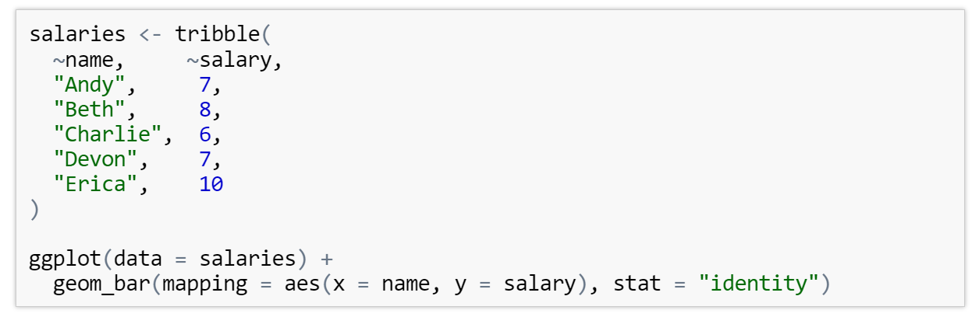
Overriding Stats
Sometimes you may wish to override the default stat choice for a geom
For example we may want to create a bar chart using stat_identity() instead of stat_count()
When we do this we supply a y aesthetic and no statistical transformation takes place

Slide 20
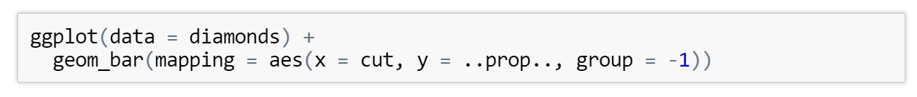
Overriding the mappings
We can also override the default mapping from transformed variables to aesthetics
For example, we can display a bar chart of proportion rather than count
As you can see, we access computed variables using the notation ..var_names

Slide 21
Geometries

Slide 22
Types of geometries
Now that we have an idea about how stats in ggplot2 behave, we can introduce some more geometries:
One variable - geom_area(), geom_density(), geom_freqpoly(), geom_histogram(), geom_bar()
Two variables (both continuous) - geom_label(), geom_text(), geom_rug()
Two variables (one discrete) - geom_col(), geom_boxplot(), geom_violin()
Two variables (both discrete) - geom_count()
Two variables (bivariate) - geom_bin2d(), geom_density2d(), geom_hex()
You can find which aesthetics these geometries require and accept by looking at their help pages

Slide 23
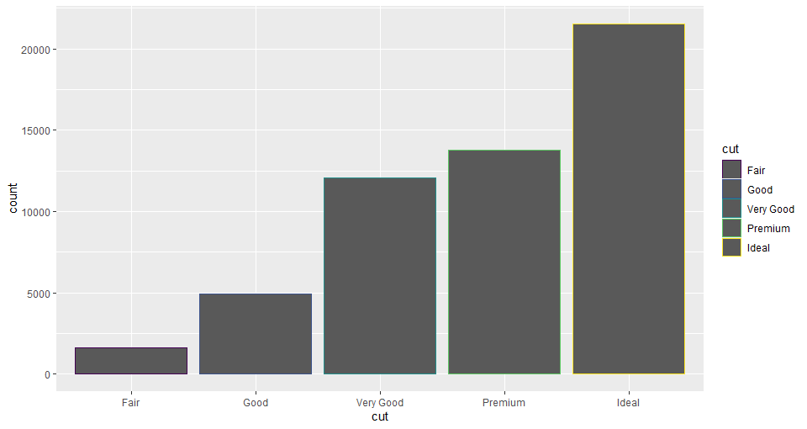
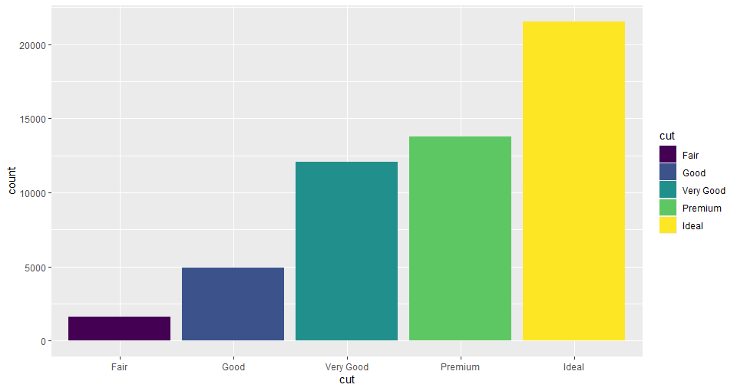
Colouring
Whereas geom_point() and geom_line() had their colours controlled entirely by the col (or color/colour) aesthetic bar charts have two aesthetics for colour
col is used for the outline colour of each bar and fill is used for the interior colour

Slide 24
Position settings

Slide 25
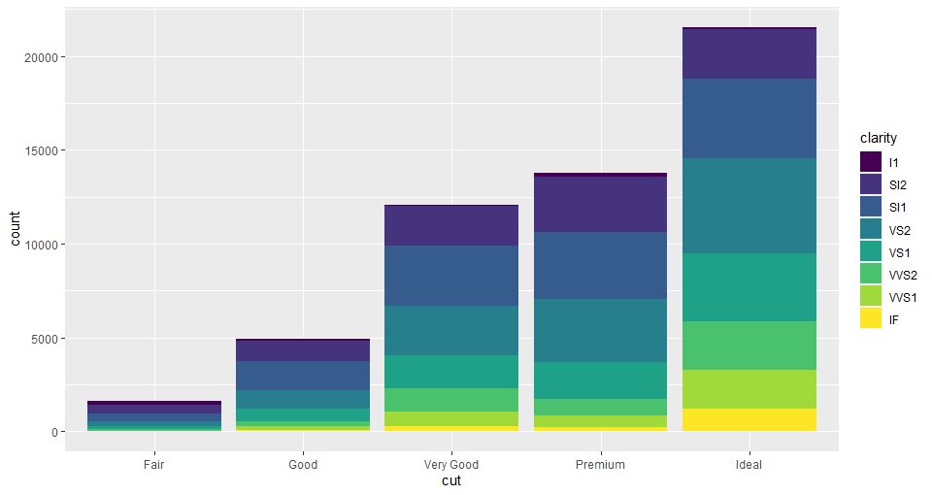
Stacked Bars
What happens when we map the fill aesthetic to one other than that being using for the x axis ?
We end up with a stacked bar chart

Slide 26
Position setting
This is because the default value of the position parameter for geom_bar is “stack”
If we didn't like this behaviour we have “identity”, “dodge”, and “fill” to choose from
“identity” will place each object exactly where it would normally fall in the graph. This will cause bars to overlap and so this should only be used with alpha set to a low value or with fill = NA and an outline colour
“dodge” places overlapping objects side-by-side. This makes it easy to compare individual observations but obscures the group behaviour
“fill” works like “stack” but makes each set of stacked bars the same height. This makes it easier to compare the breakdown of each group

Slide 27
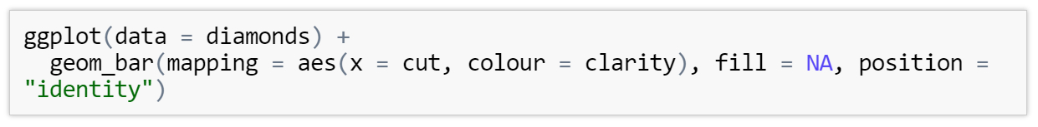
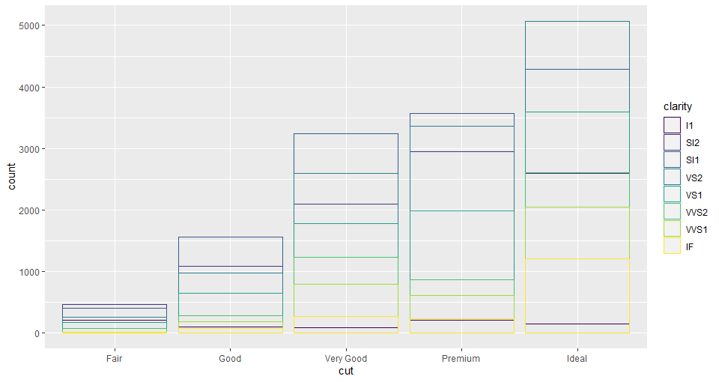
Position Identity

Slide 28
Position Settngs in scatterplots
Scatterplots also have their own position parameter (which defaults to “identity”)
Another option is “jitter”
This is used to reduce over-plotting by adding a slight bit of random noise to the position of each point
This is especially useful when you are dealing with rounded data or discrete variables
Alternatively you can use geom_jitter() which is the same as geom_point() but has a default position argument of “jitter”

Slide 29
Exercises to try
Create a bar chart of the cut variable from the diamonds dataset filled by clarity. Use position = "identity" and set transparency to a low value so all bars are visible. Is this a good plot?
Repeat the above plot but now use position = "dodge" and then position = "fill"
Which of the above plots is best for answering questions regarding what distribution the clarities have for each cut?

Slide 30
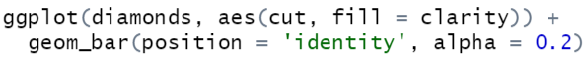
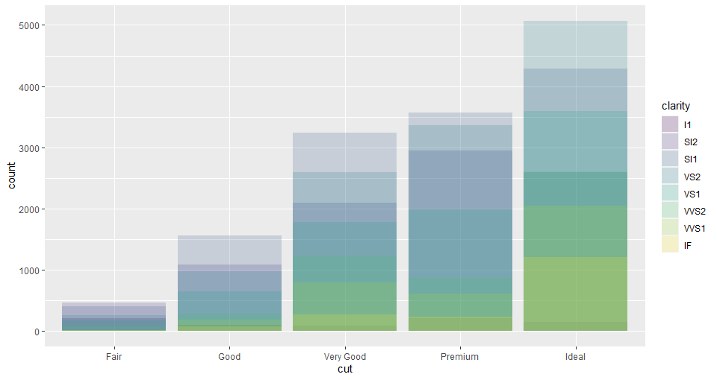
Answers

Slide 31
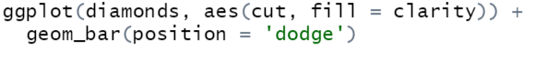
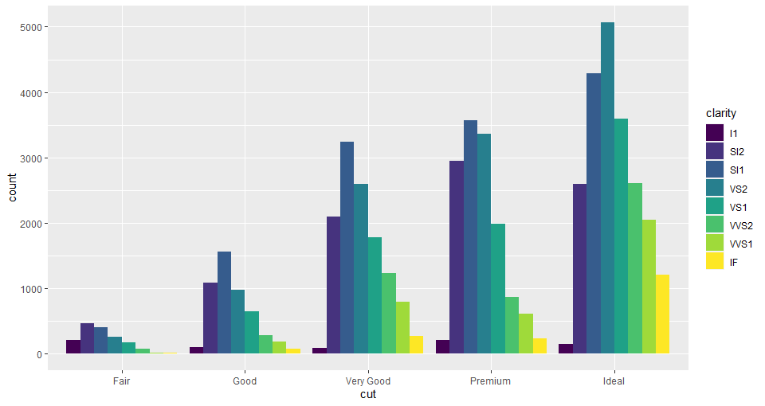
Answers

Slide 32
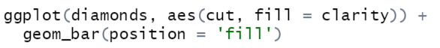
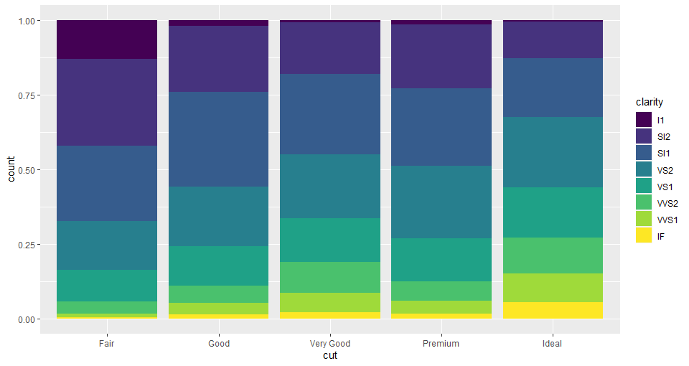
Answers

Slide 33
Next Time ….
Polar coordinates
Pie charts
More geoms
Themes
See you then !

Slide 34
Into the Tidyverse Session 5b
Course written by Tim Hardgreeves

Slide 35
Coordinate Systsems

Slide 36
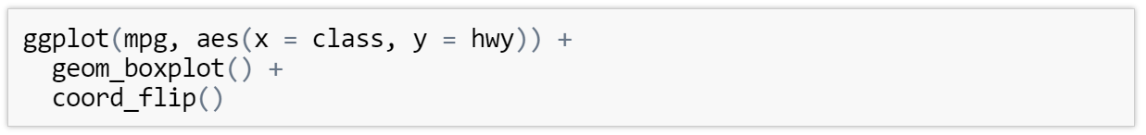
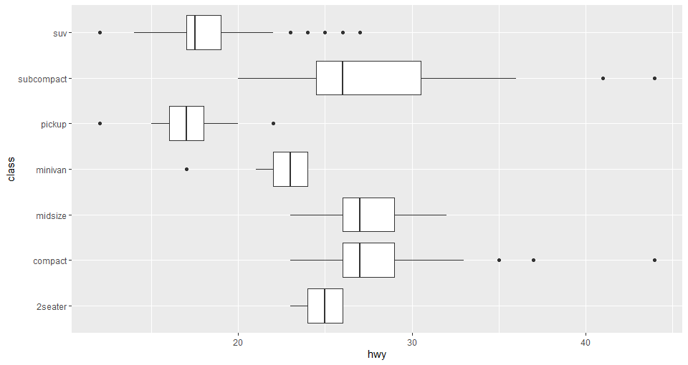
Switching Axes
You can switch the x and y axes of a plot by adding a call to coord_flip() as a new layer
This is useful when you have long labels on the x-axis that would otherwise overlap

Slide 37
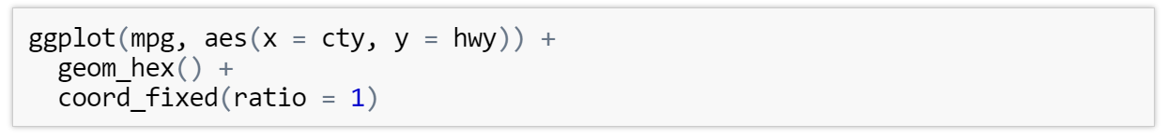
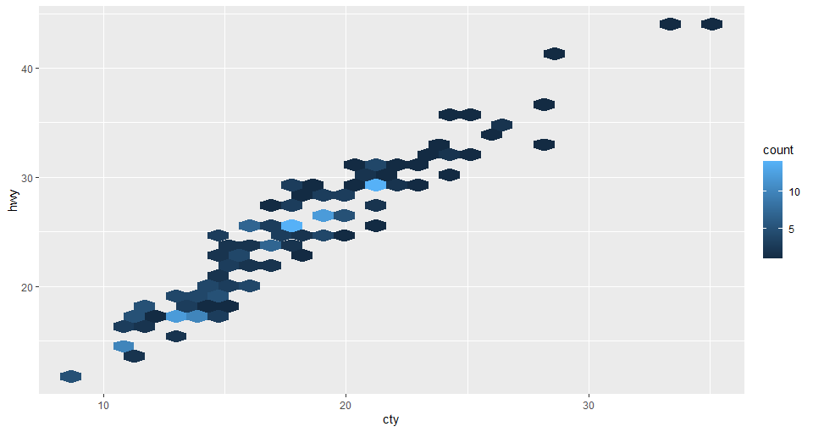
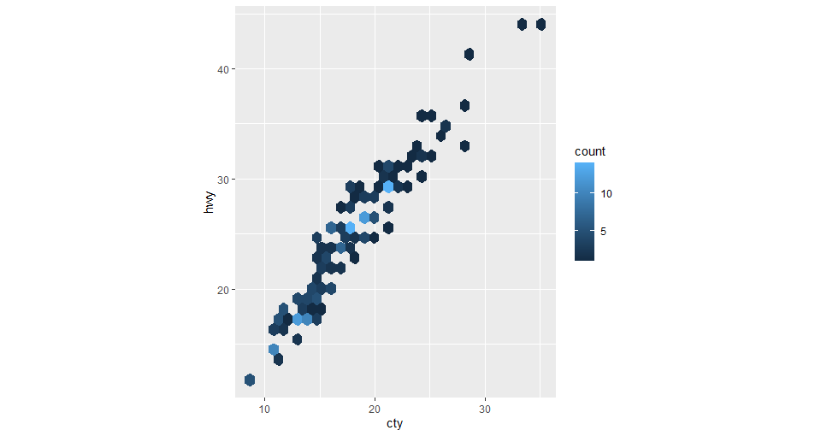
Fixing the Axis ratio
By default, ggplot will scale a graph so it fills your plotting window
You can override this behaviour and force a specific ratio using coord_fixed(ratio = ...)

Slide 38
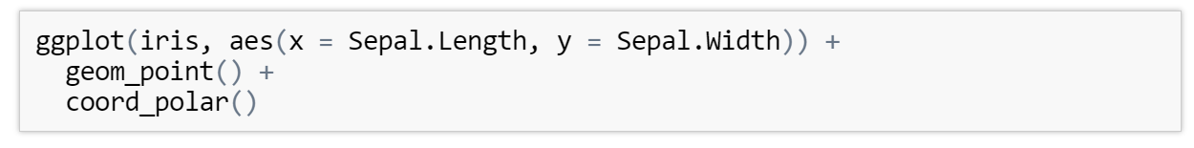
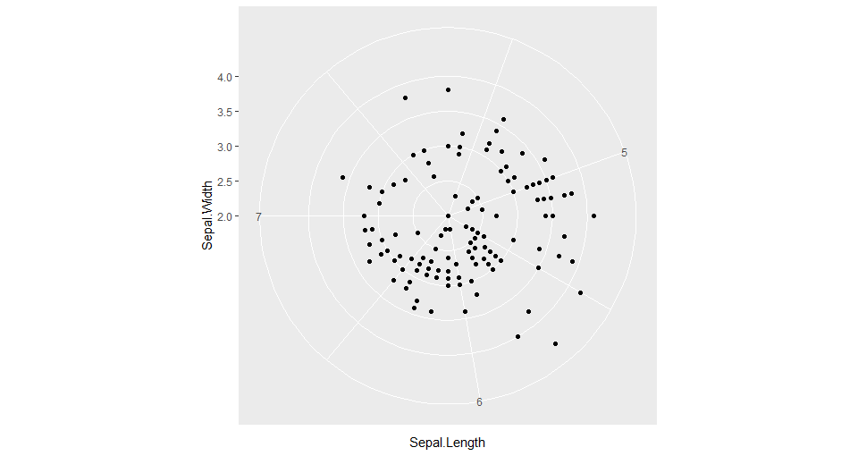
Polar Coordinates
You can use coord_polar() to treat your x and y values as r and theta in polar coordinates
It seems like there is very little point to this but this is actually how you would go about creating a pie, Coxcomb or radar plot

Slide 39
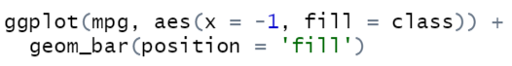
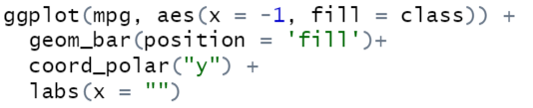
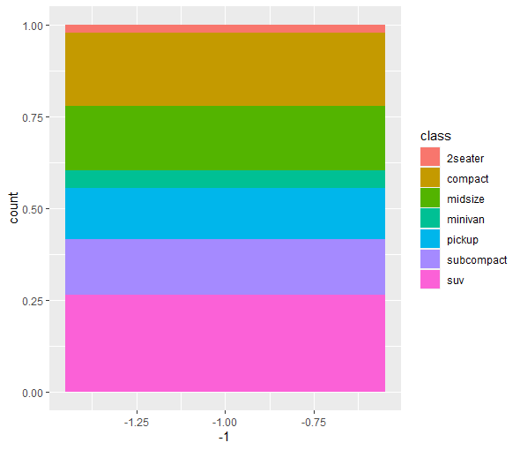
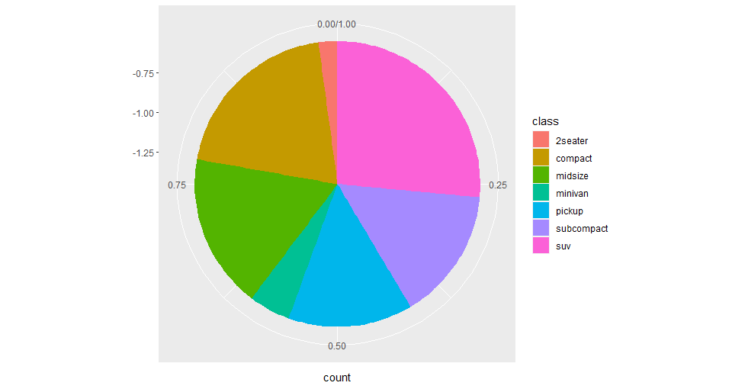
Pie Charts

Slide 40
Exercises to try
Create a horizontal bar plot of the mean price for each cut for the diamonds dataset. You will need to use group_by(), summarise() and then either geom_col() or geom_bar() with stat = "identity“
Create a pie chart of any appropriate variable you wish from the diamonds dataset

Slide 41
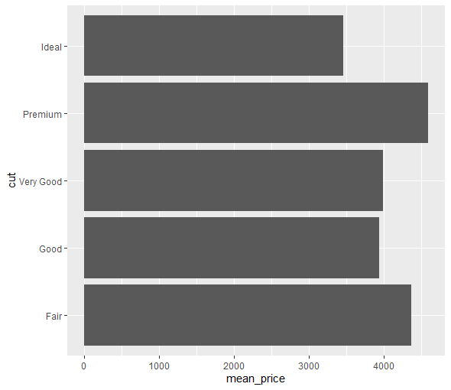
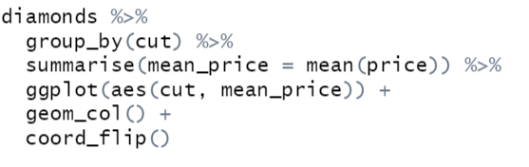
Answers

Slide 42
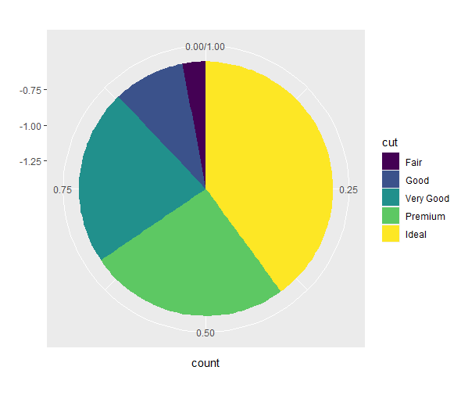
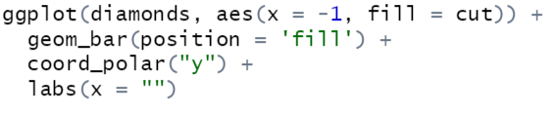
Answers

Slide 43
Themes

Slide 44
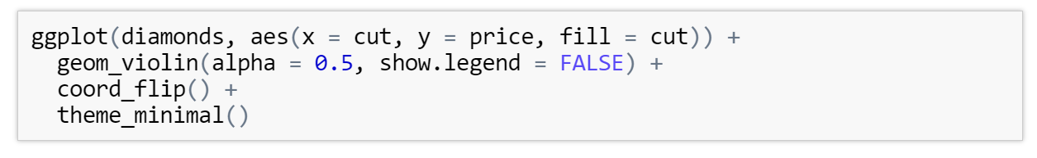
Ggplot Themes
ggplot comes with several complete themes which control all non-data display
The default theme is theme_grey()
Some good-looking themes to try out include theme_classic(), theme_bw(), and theme_minimal()
You can find a list of all themes by looking at the help page for any theme (e.g. ?theme_grey)
You can change the theme of a plot by adding a theme function as a new layer

Slide 45
Overriding default Themes
The default theme for each plot you create can be found by calling theme_get()
At the start of a new R session, this will always be theme_grey()
You can override this default by using, theme_set(theme_minimal())
theme_set() returns the old theme when called
It is good practice to use old_theme <- theme_set(theme_minimal()) so that the original theme can be restored if needed

Slide 46
Adjusting the individual components of a theme
You can adjust individual components of a theme by adding a theme() layer
This function can take hundreds of parameters, each corresponding to a unique element of the plot
You can find a list by using ?theme
For each parameter we pass in one of <element>_blank() (remove the element), <element>_rect(), <element>_line(), <element>_text()
We can then specify ways of theming the element in this functionFor example we can make the x-axis label red using theme(axis.text.x = element_text(colour = 'red')) as a new layer

Slide 47
Exercises to try
Create hex plot of petal length and width with the iris dataset. Apply different themes to this and decide on your favourite
Create a scatter plot of sepal length by width coloured by species. Use theme(legend.position = "bottom") to move the legend. What about "left" and "top"? What does legend.position = "none" do?

Slide 48
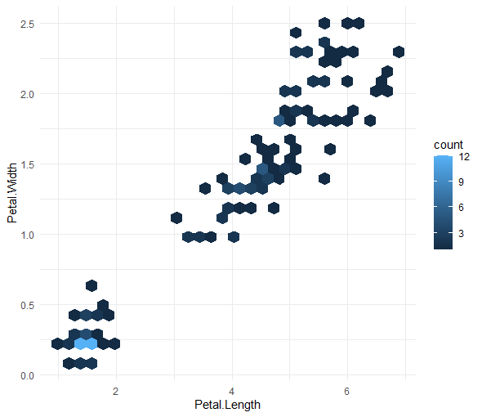
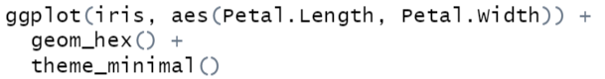
Answers
1)
2)
We use legend.position = "none" to hide the legend.

Slide 49
Ggplot summary

Slide 50
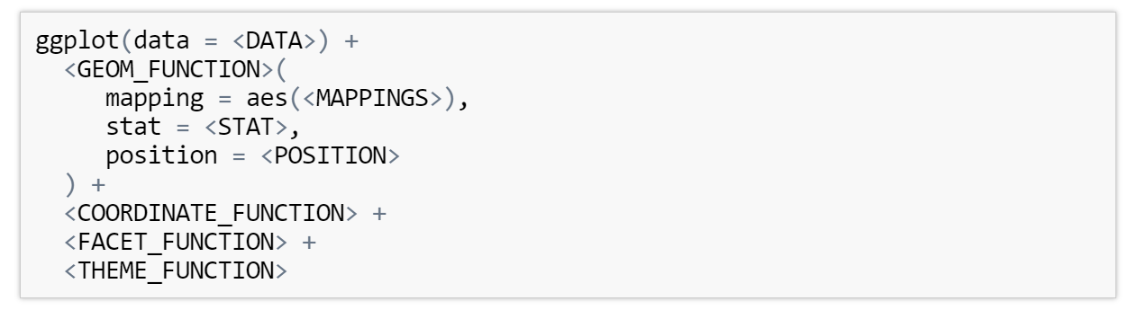
All the layers
We have covered a lot about ggplot2 in the several session involving it
This foundation is powerful enough to produce essentially any type of plot you can imagine
Note that the geom and theme functions can actually be multiple geoms and themes layered one on top of the other

Slide 51
Going further

Slide 52
Ggplot extensions
Although ggplot is an immensely powerful tool, it does have limitations
Here are a few extensions that may be of interest:
gganimate - turn static ggplot2 plots into animations using only a few lines of code
ggthemes - more themes, more geometries, more scales
ggrepel - repel overlapping text labels away from each other
geofacet - create facets that map to real-life geography

Slide 53
Bonus Questions

Slide 54
Lets look at 3D graphs !
Why 3D:
If we have 2 or more predictive variables 3D plots are really good to see all the variables interactions
If a dataset has both positive and negative effects from different continuous variables we can loose sight of our relationships when just in 2D
We’ll be using the package scatterplot3d and car to complete our 3D graphs so go ahead and install and load those packages
The car package has a built in dataset called Soils which we will be using for the plot

Slide 55
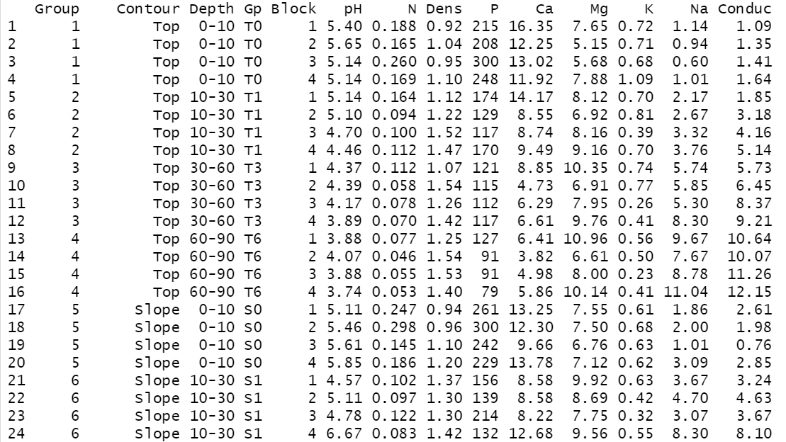
Soil Dataset
Load in the Soils dataset and assign it to an object called soil_df

Slide 56
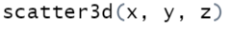
3D plot
We firstly need to assign 3 variables x – sodium content , y- soil pH, and z – conductivity
Now we can create our 3D scatterplot:

Slide 57
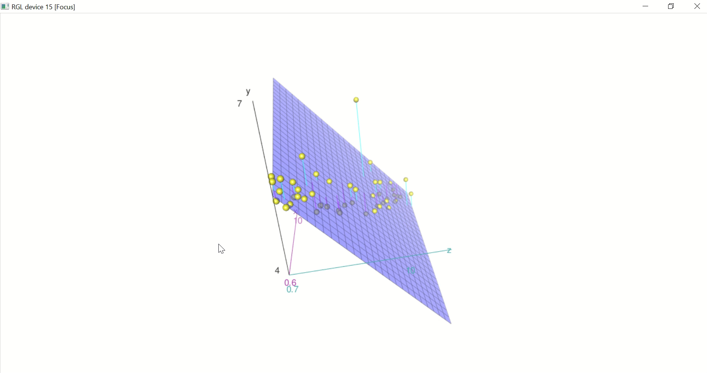
So this is our output an interactive RGL device but it’s quite hard to read currently !
But we can see theres an outlier that wouldn’t of been spotted in a 2D graph

Slide 58
Customizing
We haven’t got any labels currently so add some x, y and z labels to you plot:
scatter3d(x, y, z, xlab=“any name”, ylab=“any name”, zlab=“any name”)
Lets get rid of the surface plot currently interesting out graph :
plot3d(x, y, z, surface= FALSE)

Slide 59
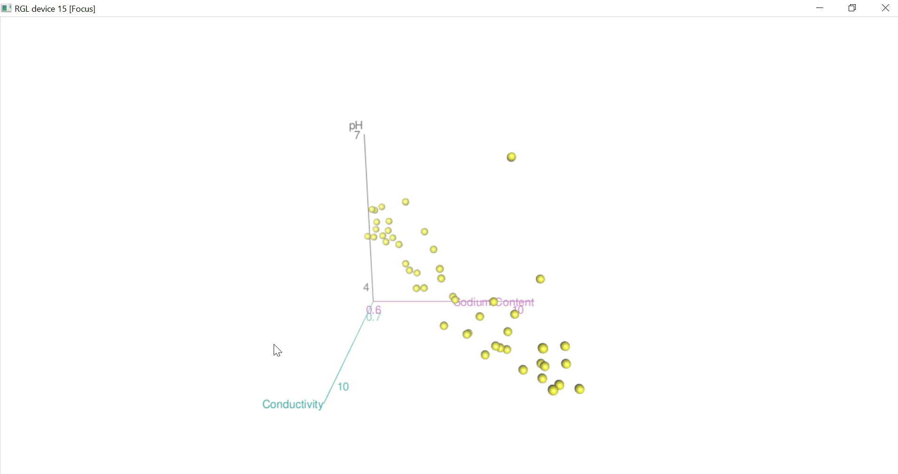
Much better !
You can read the documentation here to find out more about 3D graphs with rgl :
https://cran.r-project.org/web/packages/plot3D/plot3D.pdf

Slide 60
Thank You !

Slide 61
Resources
As stated in session one, there are many ways to access resources on the tidyverse:
Stack Overflow is a great resource
Simply web-searching your problem followed by one of 'R', 'Tidyverse', or the specific tidyverse package you are using will return you many helpful guides
The tidyverse has a website with help guides, tutorials, and full documentation
You can also check out the cheat sheets for each of the packages we're using, though these are quite in-depth
Best of luck!

